Slide 1
Mass-Spring-Simulation
2019-2 Interective Visualization PA#2
2016320189 이광렬

Slide 2
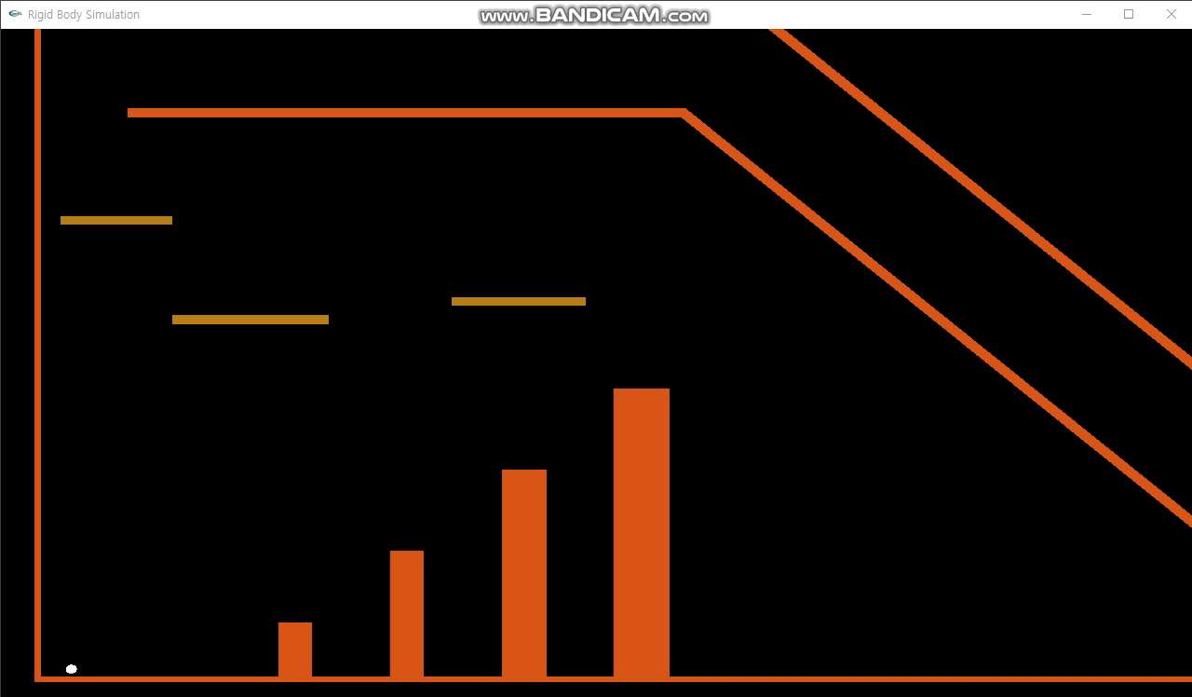
PA#1 Demo Video

Slide 3
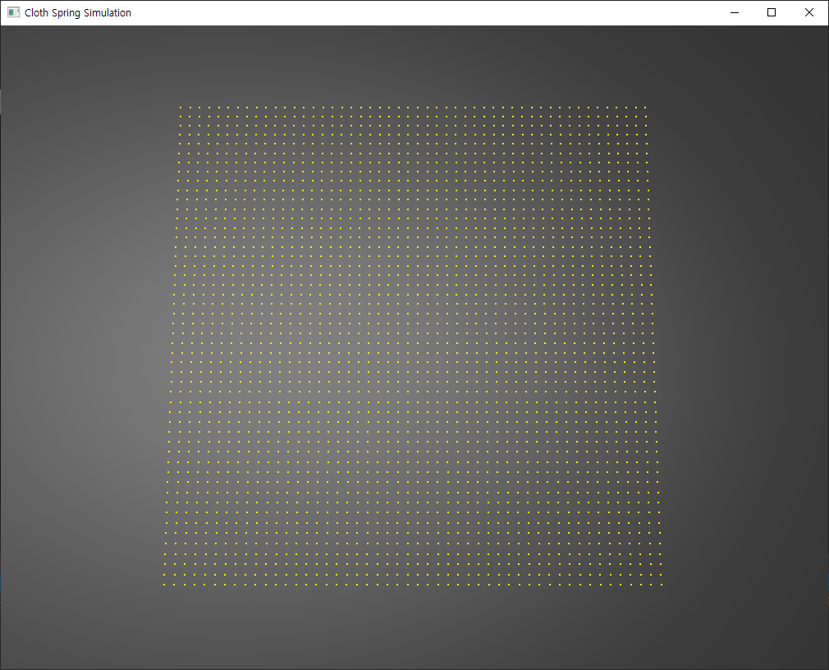
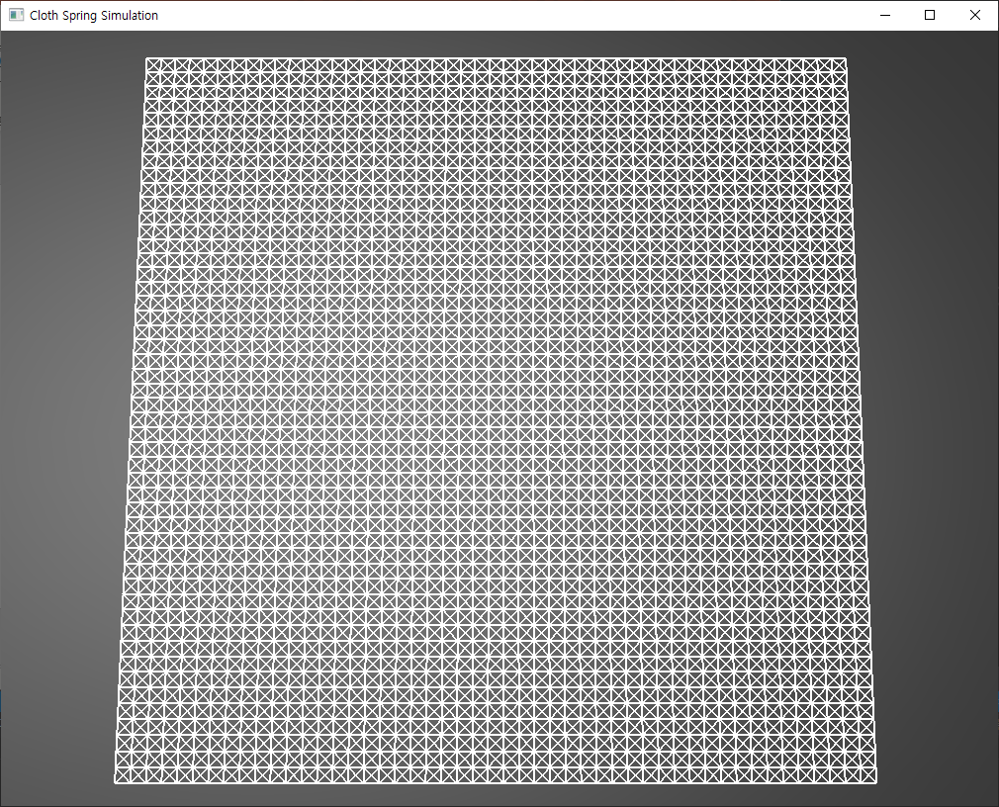
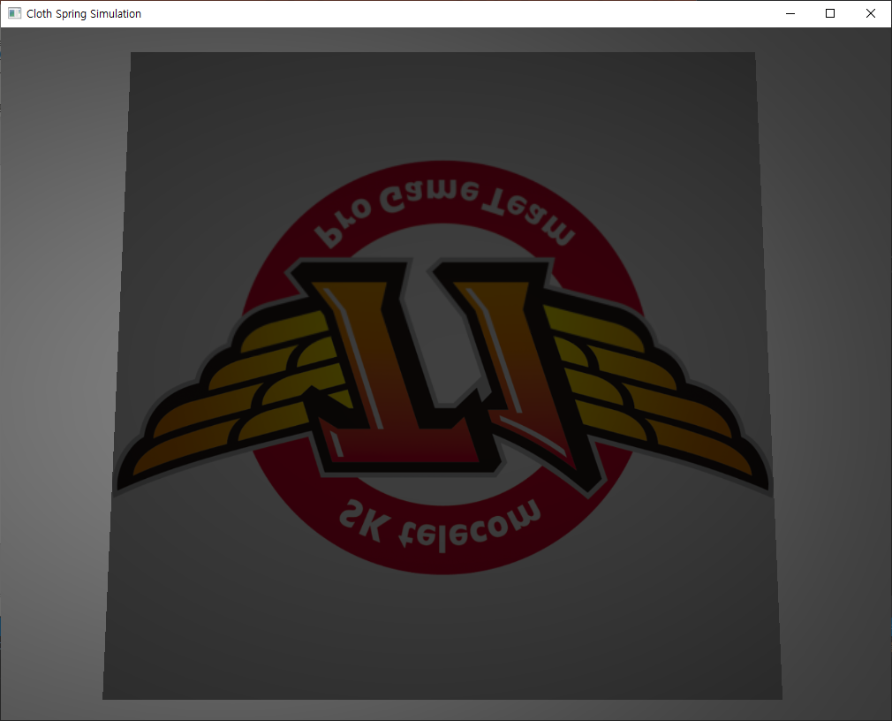
구현 사항
Node Spring Face(with Texture)
Force(Hooke’s Law + Damping Force)
Integration(Euler’s Explicit Method)

Slide 4
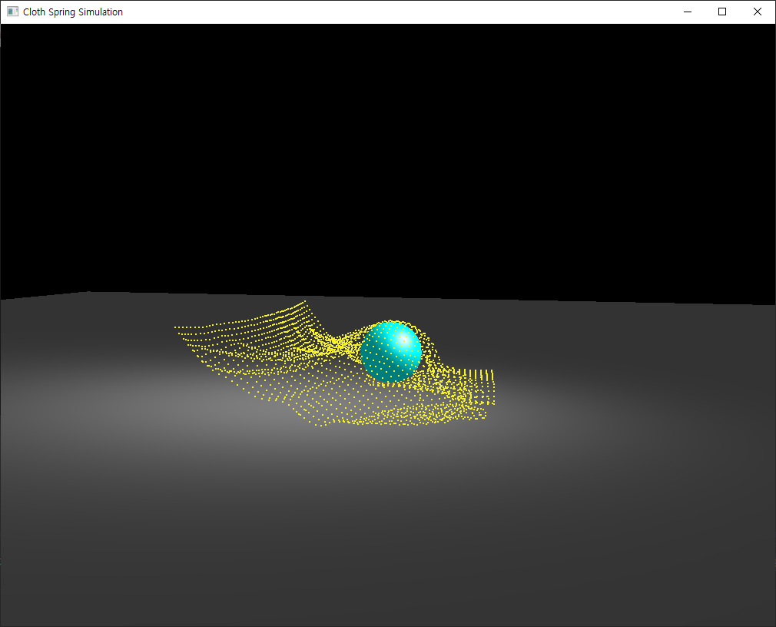
구현 사항
Rendering(compute normal)
User Interaction(Mouse input)
Collision : ground - cloth
: Sphere - cloth

Slide 5
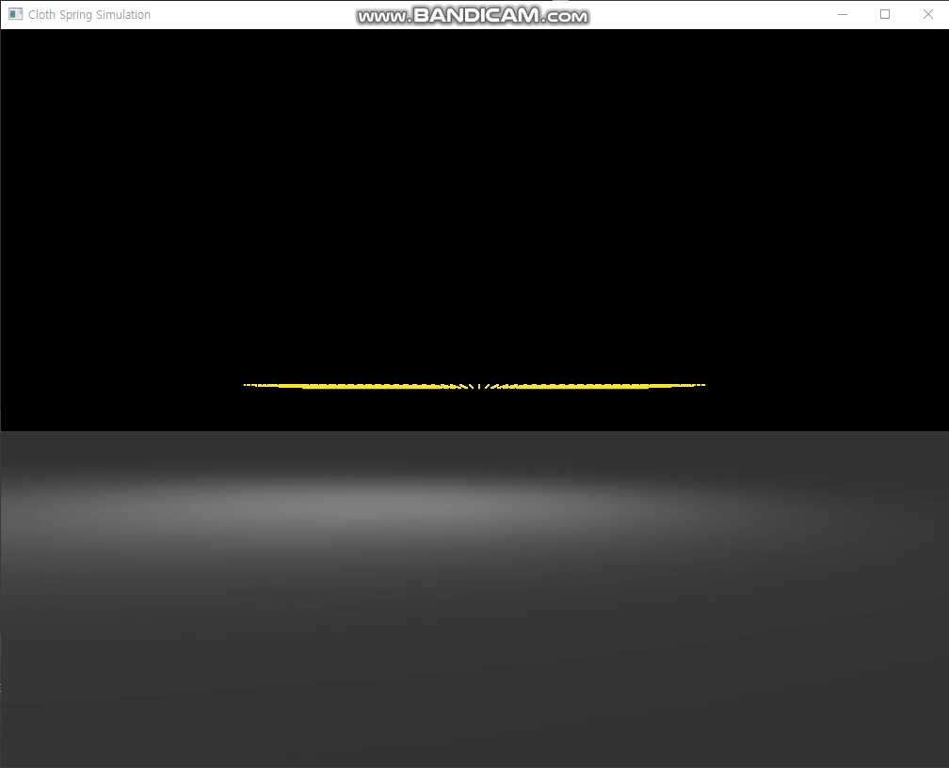
PA#2 Demo Video

